Slide 1
Implementation of Decision Tree using ID3 Algorithm
-Garseri Bhavani
(ML Engineer)

Slide 2
Introduction to Problem statement-Titanic Disaster
The sinking of the Titanic is one of the most infamous shipwrecks in history.On April 15, 1912, during her maiden voyage, the widely considered “unsinkable” RMS Titanic sank after colliding with an iceberg. Unfortunately, there weren’t enough lifeboats for everyone onboard, resulting in the death of 1502 out of 2224 passengers and crew.While there was some element of luck involved in surviving, it seems some groups of people were more likely to survive than others.In this challenge, we ask you to build a predictive model that answers the question: “what sorts of people were more likely to survive?” using passenger data (i.e. name, age, gender, socio-economic class, etc.)

Slide 3
Introduction of Attributes:
The titanic. csv file contains data for 891 of the real Titanic passengers. Each row represents one person.
survival - Survival (0 = No; 1 = Yes)
class - Passenger Class (1 = 1st; 2 = 2nd; 3 = 3rd)
name - Name
sex - Sex
age - Age
sibsp - Number of Siblings/Spouses Aboard
parch - Number of Parents/Children Aboard
ticket - Ticket Number
fare - Passenger Fare
cabin - Cabin
embarked - Port of Embarkation (C = Cherbourg; Q = Queenstown; S = Southampton)

Slide 4
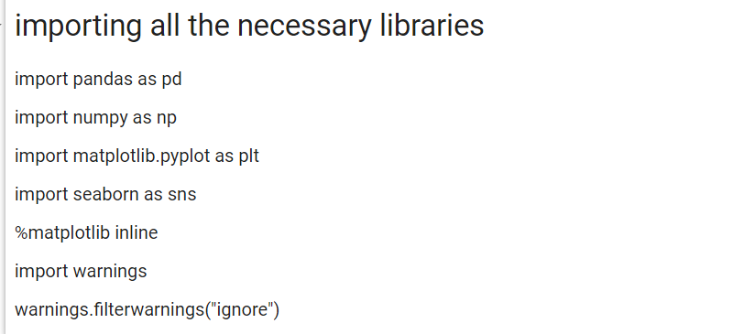
STEP-1
Importing all the necessary libraries.
Read the dataset and load csv data in python.
Therefore,the dataset consist of 891 rows and 12 columns.
Checking the dtypes and information of attributes.

Slide 5
Step-2 Data Pre-Processing
In Pre-processing , we are checking the null values using “df.isnull().sum()”.
Therefore,there are no null values in given dataset.
We have checked the duplicate values using “df.duplicated().sum().
We are dropping some unnecessary attributes-"PassengerId","Ticket","Cabin","Name".
we are dropping Passenger Id and ticket because they have more unique values.
we are dropping Name and cabin because they have more null values.

Slide 6
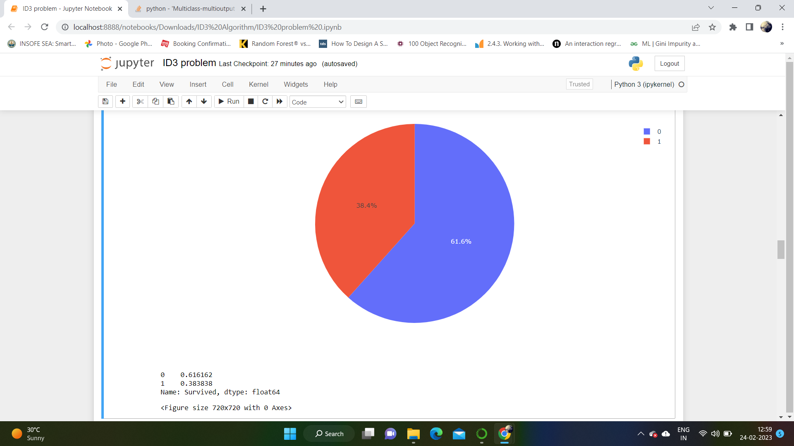
Step-3 Exploratory Data Analysis
From below Pie chart, we got to know that 61% of people are not survived and 38% of people are survived.

Slide 7
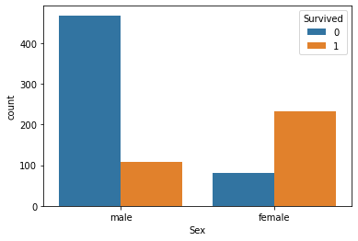
From this graph, we can see the count of male and female people are survived.

Slide 8
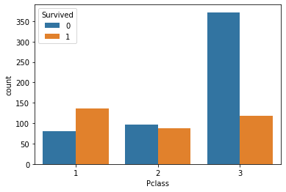
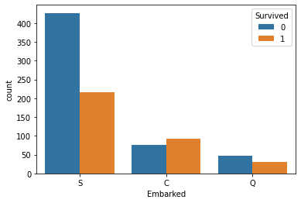
So,we can conclude that most of the passengers were affected from Pclass3 than Pclass1 and Pclass2.
After observing above plot,we can evaluate that passengers those who embarked at port "C" has higher surviving rate compared to port "S" and port "Q".

Slide 9
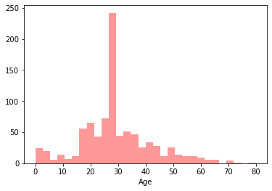
Those who were 20 to 30 years were more dead.

Slide 10
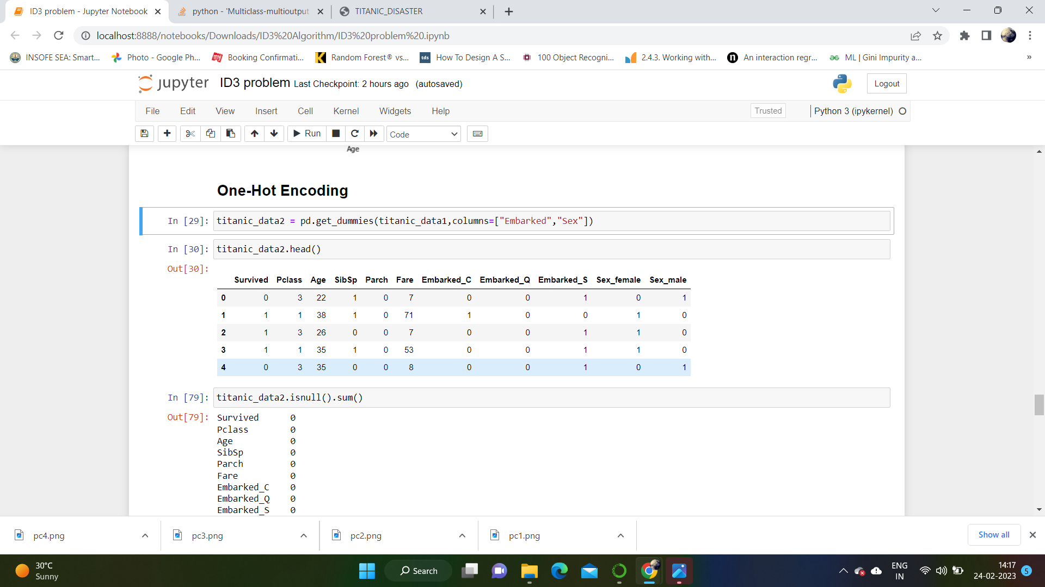
Step-4 One-Hot Encoding
One - hot encoding is a common method for dealing with categorical data.

Slide 11
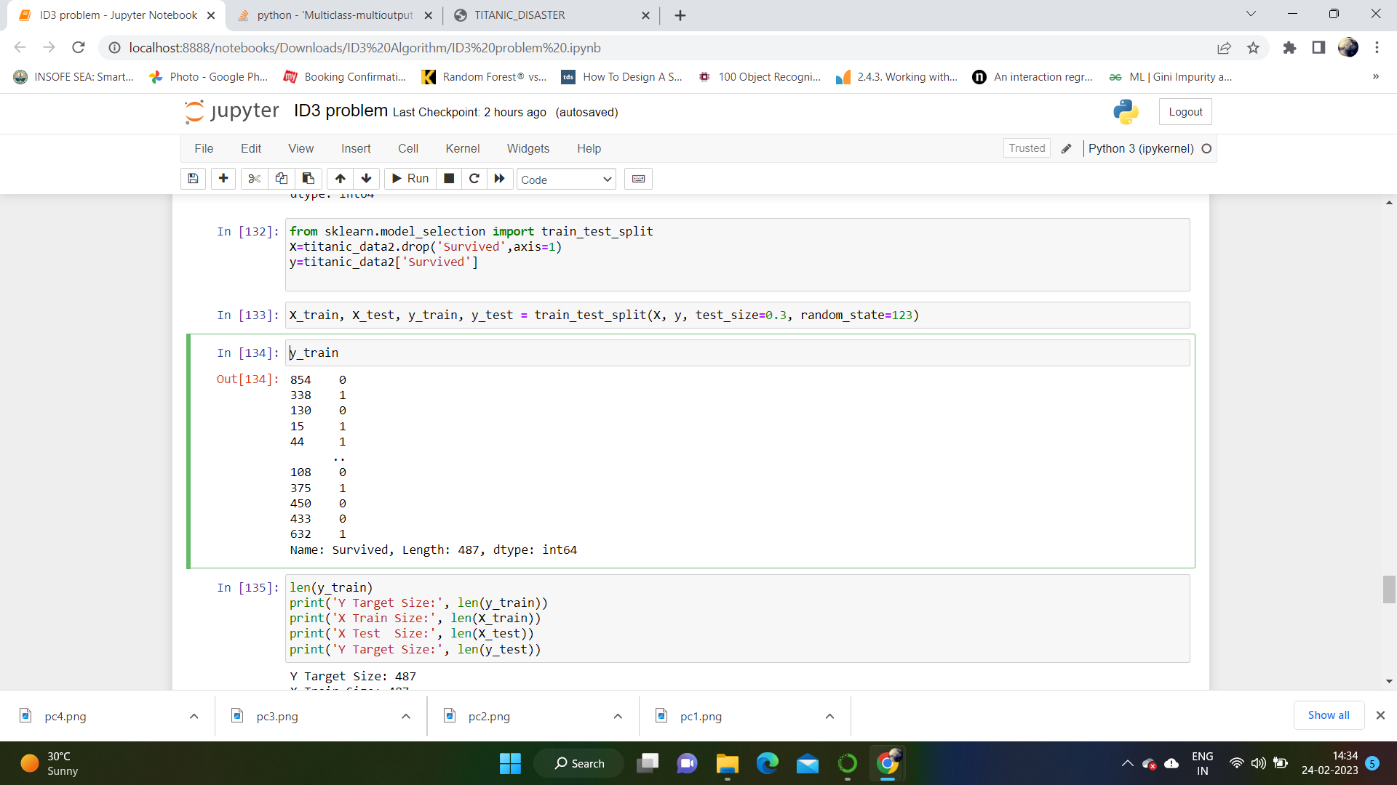
Step-5 Splitting data into train and test split
In this we have given random _ state, because we set random _ state to fixed integer value then the function will randomly split data into train and test. But the split will be same every time you run the code.

Slide 12
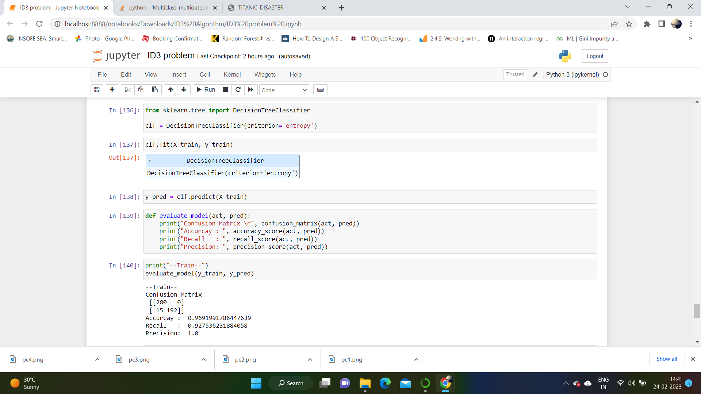
Step-6 Building the model

Slide 13
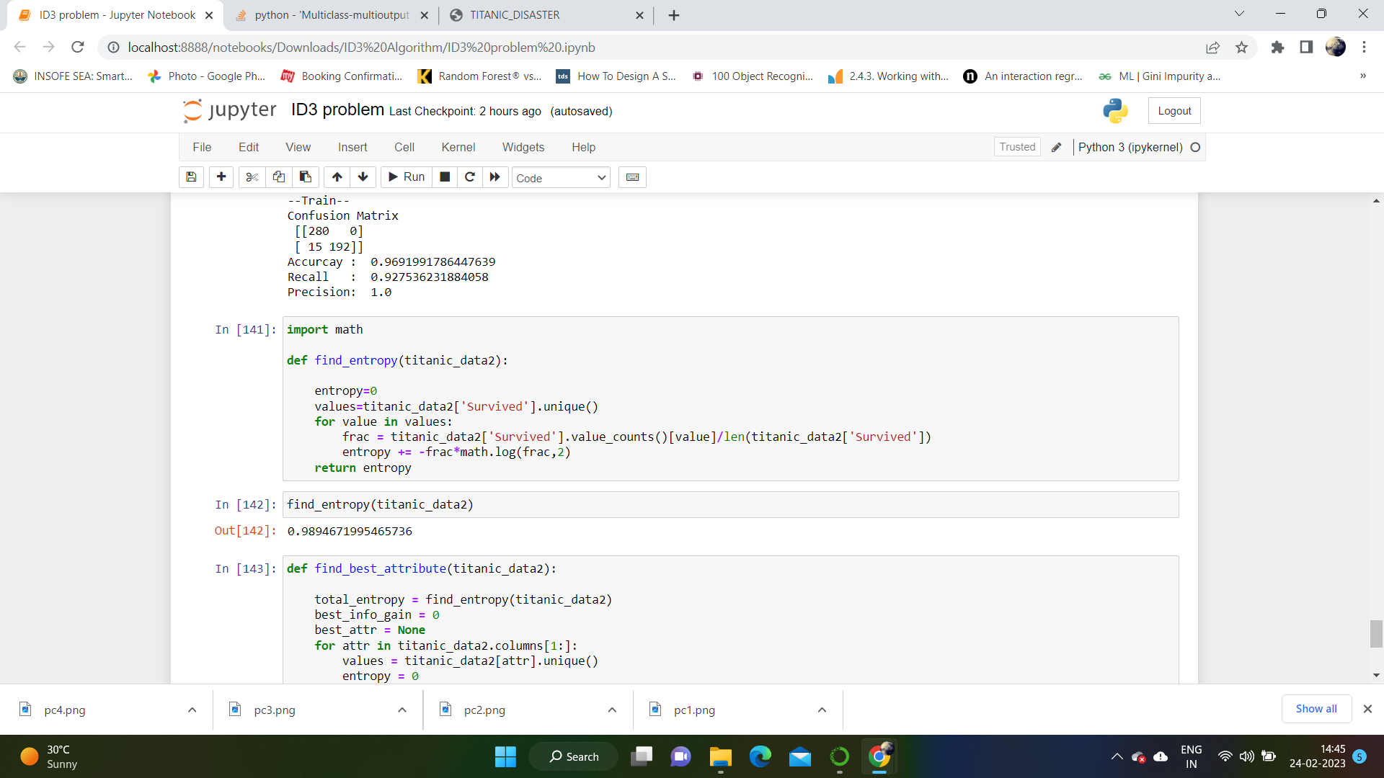
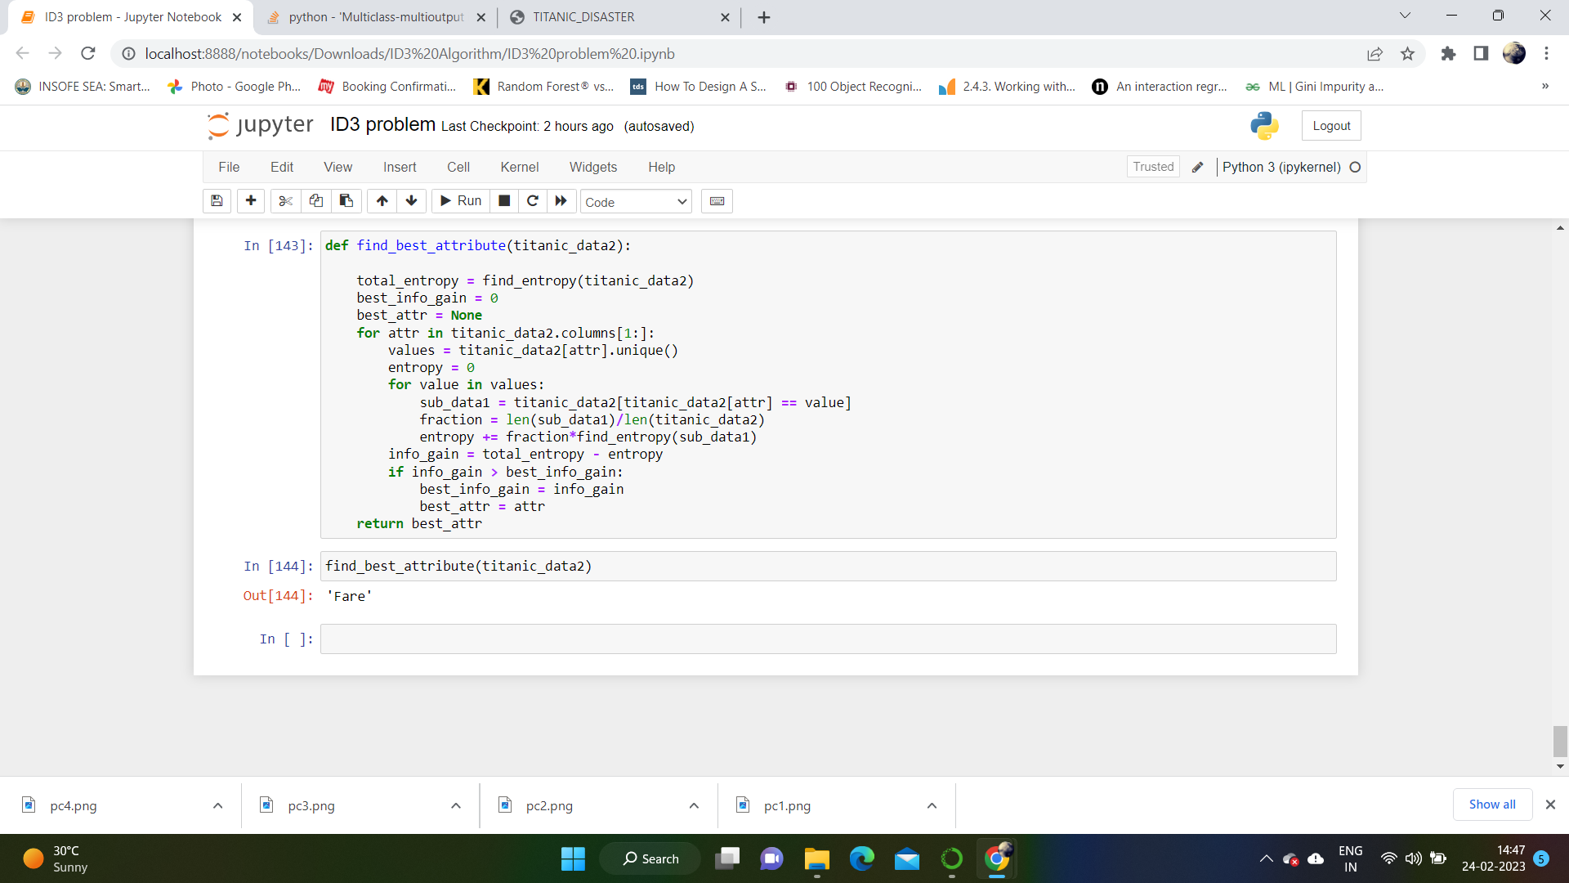
Step-6 Code for decision tree using ID3 from scratch

